Slide 1

[Samsung PRISM] Preliminary Discussion
Surface detection from Image
Team
College Professor(s): Dr. Sini Anna Alex and Dr. Rajarajeswari S
Samsung Mentor: Akhilesh Parmar
Students:
Haarish Anandan(CSE)
Tejas Hegde(CSE)
Rahul Kumar(ECE)
Satyam Satyarthi(ECE)
**Pranamya Kashyap MP(CSE)

Slide 2
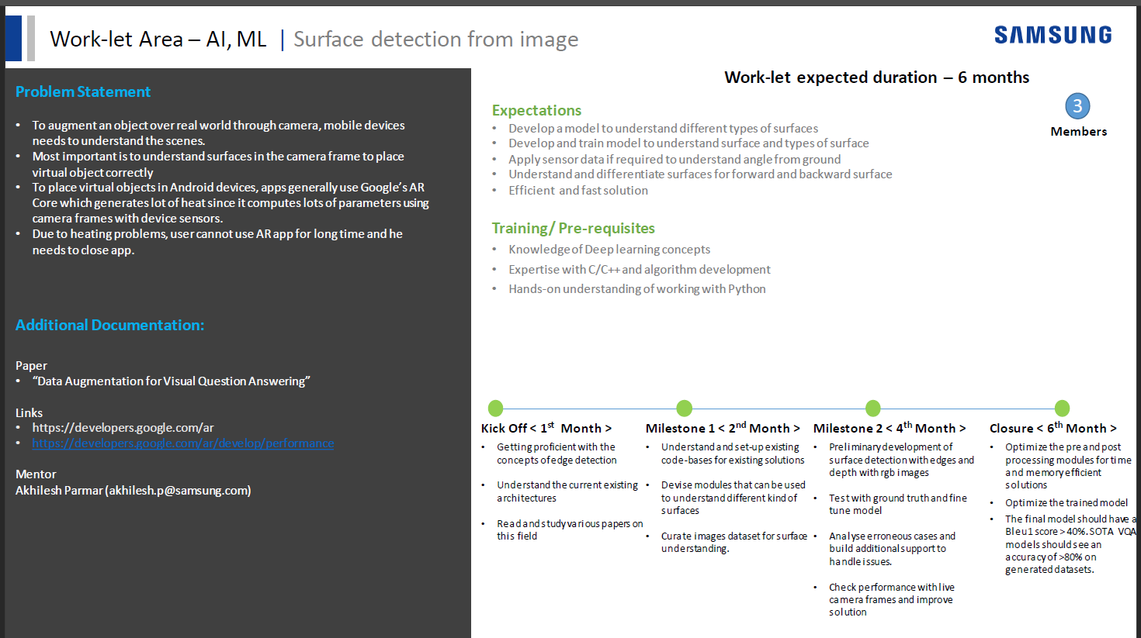

Slide 3
Proposed Approach / Solution
Concept Diagram :
( Clear detailed schematic / block diagram / flow chart depicting the proposed concept / solution )
Flat Surface Images
Dataset for Detection of Various types of Surfaces
Surface Detection Classifier
Trained On
Vertical Surface Images
Slanted Surface Images

Slide 4
Dataset(s) Analysis / Description
Dataset Capture / Preparation / Generation :
(Discuss the dataset generation process or if downloaded data provide details of what data & from where it was obtained etc… - 2 to 3 bullets only)
The dataset which has been used to train the model has been procured manually by us by downloading images from the internet
No existing implementations, research papers and datasets for surface detection.
Raw data captured from the internet of different file formats and image sizes.
These datapoints are prepared by converting to uniform formats.
Dataset Understanding / Analysis :
(Provide 2 to 3 bullets about what is your understanding of the data / opinion about the data)
The dataset has been divided into 3 distinct classes: flat surfaces, vertical surfaces and slant surfaces
The image formats are jpg and png, of varying sizes.
The image type is RGB color coding.
Dataset Pre-Processing / Related Challenges (if any) :
(List out the challenges you foresee in data handling wrt problem definition – 2 to 3 bullets only)
Data pre-processing techniques will be incorporated in the future to improve accuracy.
Major challenge faced is in procuring dataset manually.
Another challenge is procuring dataset of close up shots of flat surface.

Slide 5
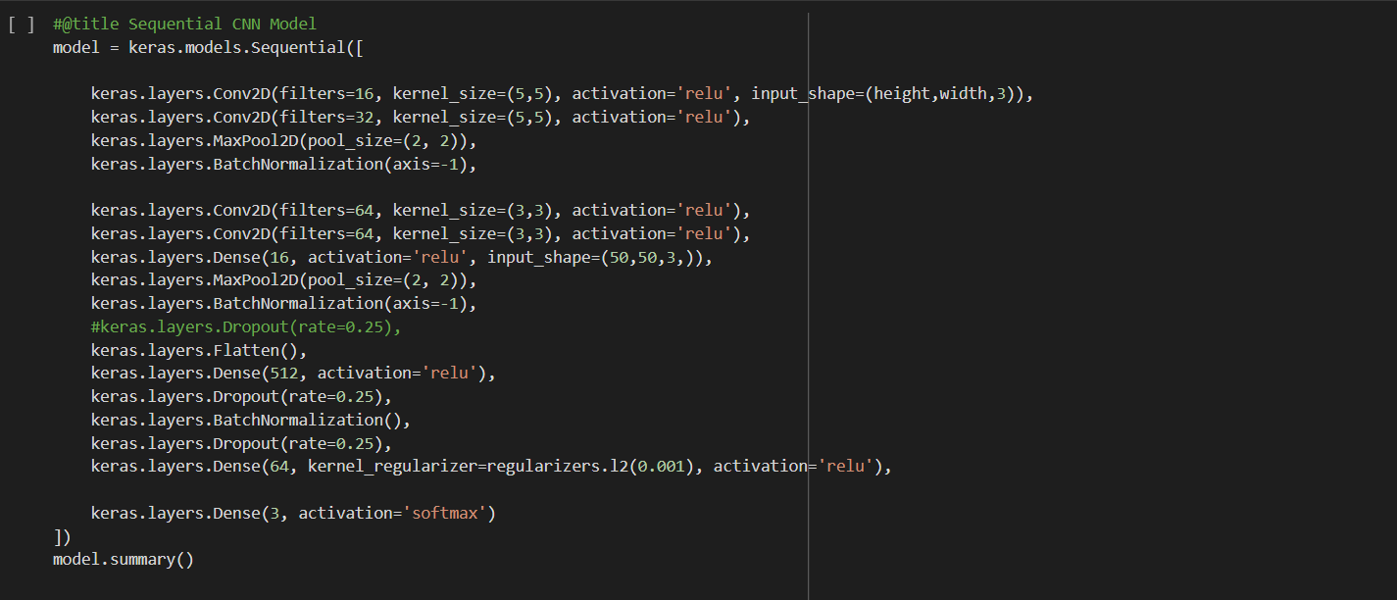
Experimental Results / Simulations / Observations
Major Observations / Conclusions & Challenges :
(provide details about your findings, experimental opinion – Use separate slide if necessary)
Architecture of model 1

Slide 6
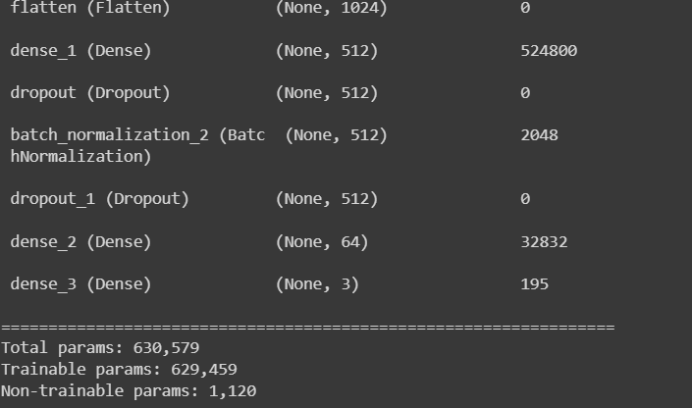
Experimental Results / Simulations / Observations
Major Observations / Conclusions & Challenges :
(provide details about your findings, experimental opinion – Use separate slide if necessary)
Summary of model 1

Slide 7
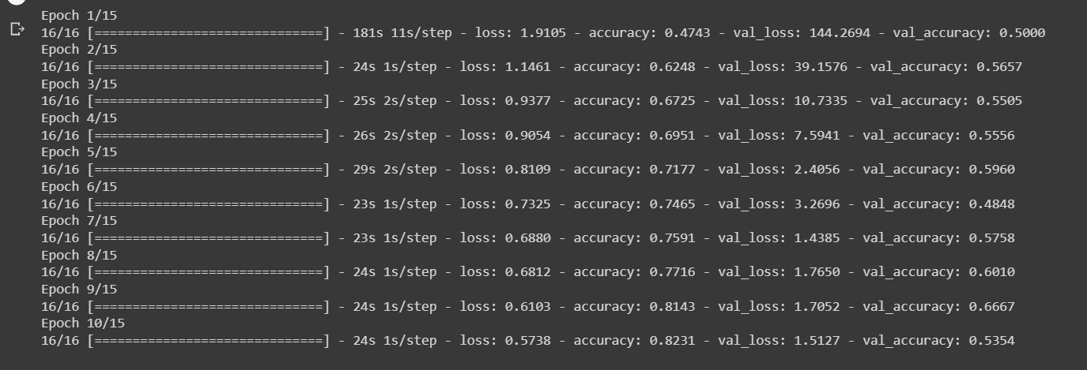
Experimental Results / Simulations / Observations
Results :
(provide numerical data / bar charts / plots / images / videos / tabulated results etc. Use full slide or multiple slides up to max 3 slides to demonstrate the results)
Training of model 1

Slide 8
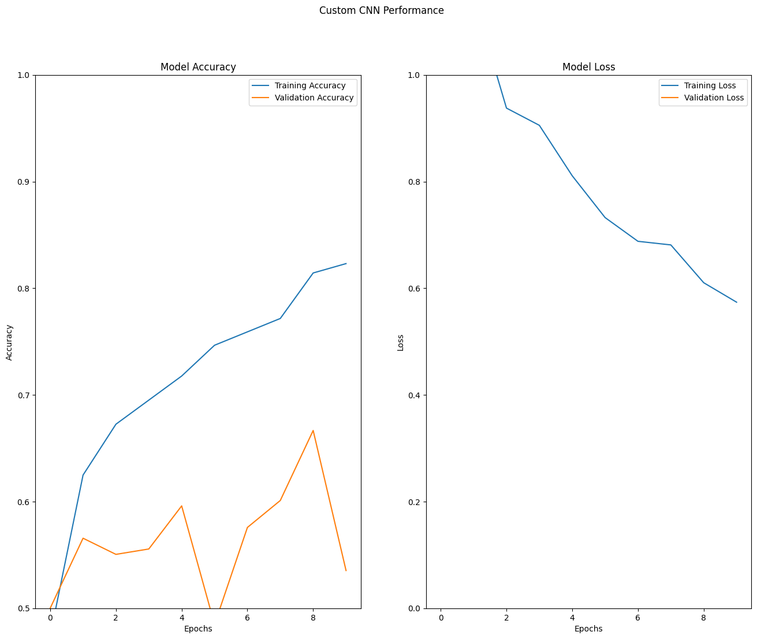
Experimental Results / Simulations / Observations
Model 1
Training vs Validation
Epoch vs Accuracy
Epoch vs Loss

Slide 9
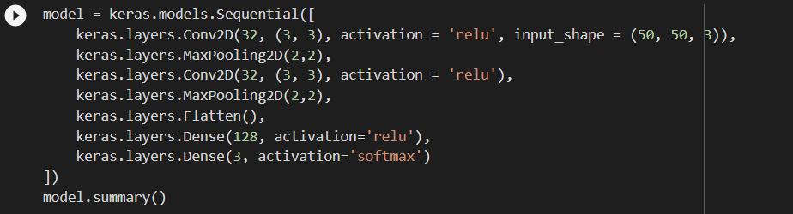
Experimental Results / Simulations / Observations
Major Observations / Conclusions & Challenges :
(provide details about your findings, experimental opinion – Use separate slide if necessary)
Architecture of model 2

Slide 10
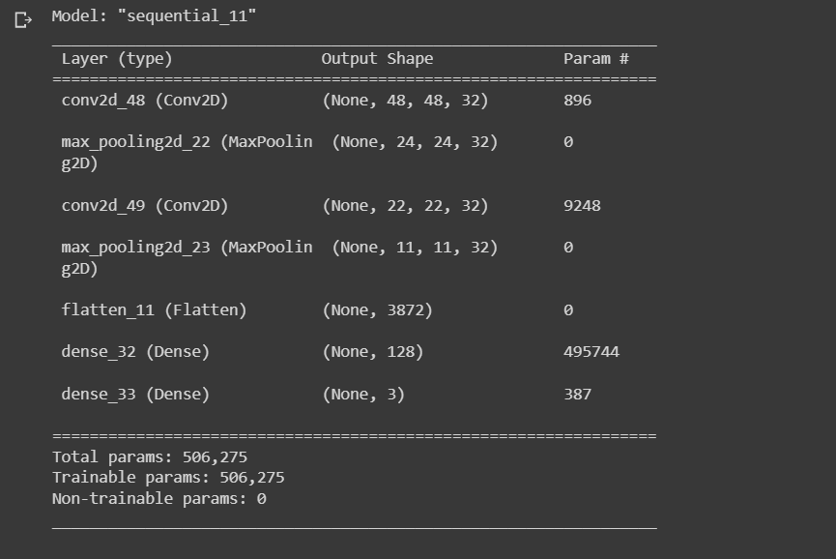
Experimental Results / Simulations / Observations
Major Observations / Conclusions & Challenges :
(provide details about your findings, experimental opinion – Use separate slide if necessary)
Summary of model 2

Slide 11
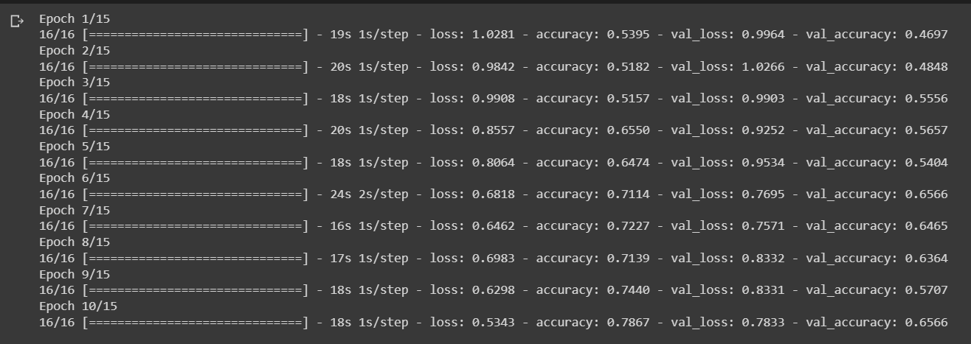
Experimental Results / Simulations / Observations
Results :
(provide numerical data / bar charts / plots / images / videos / tabulated results etc. Use full slide or multiple slides up to max 3 slides to demonstrate the results)
Training of model 2

Slide 12
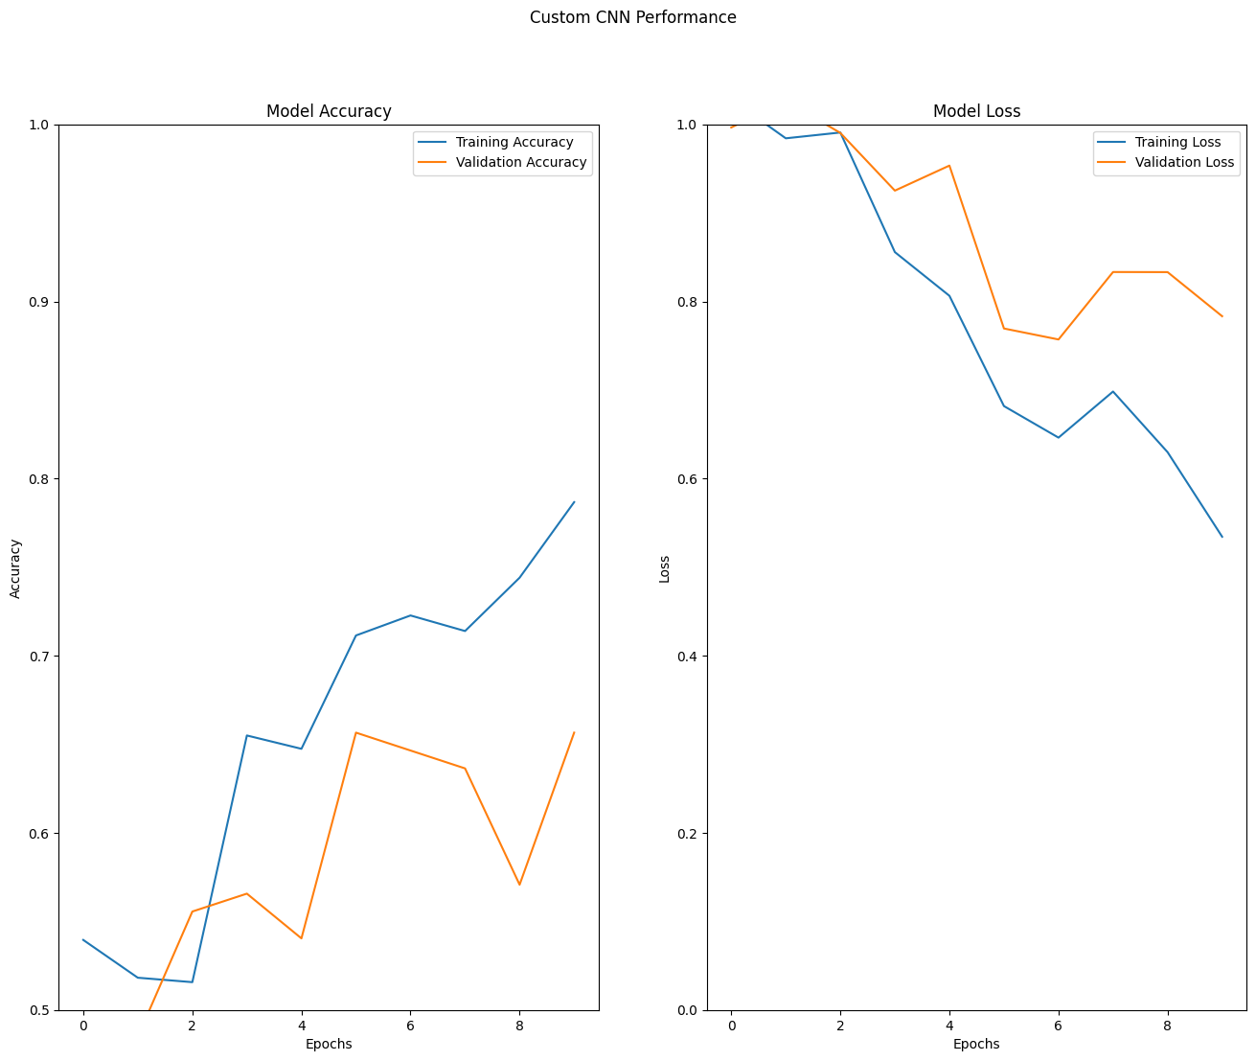
Experimental Results / Simulations / Observations
Model 2
Training vs Validation
Epoch vs Accuracy
Epoch vs Loss

Slide 13
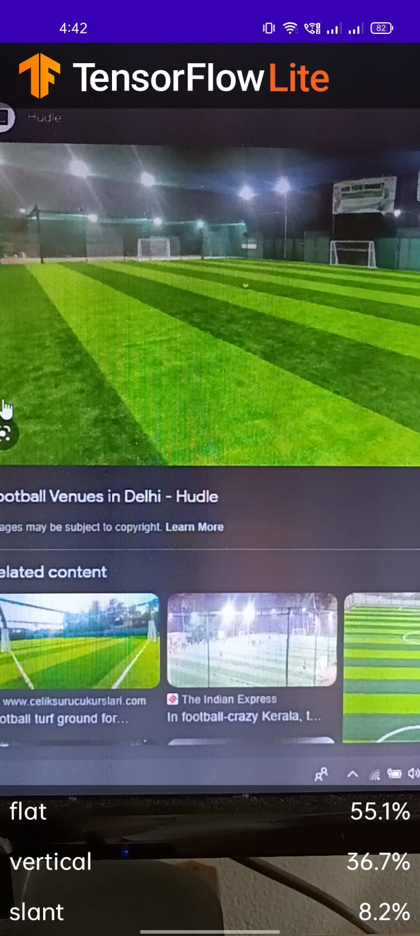
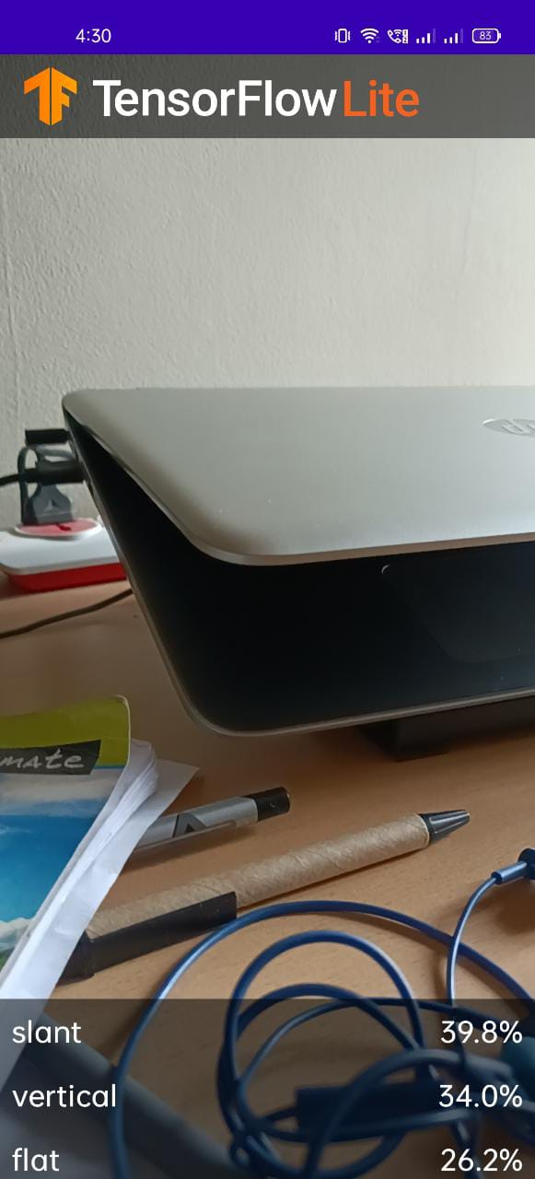
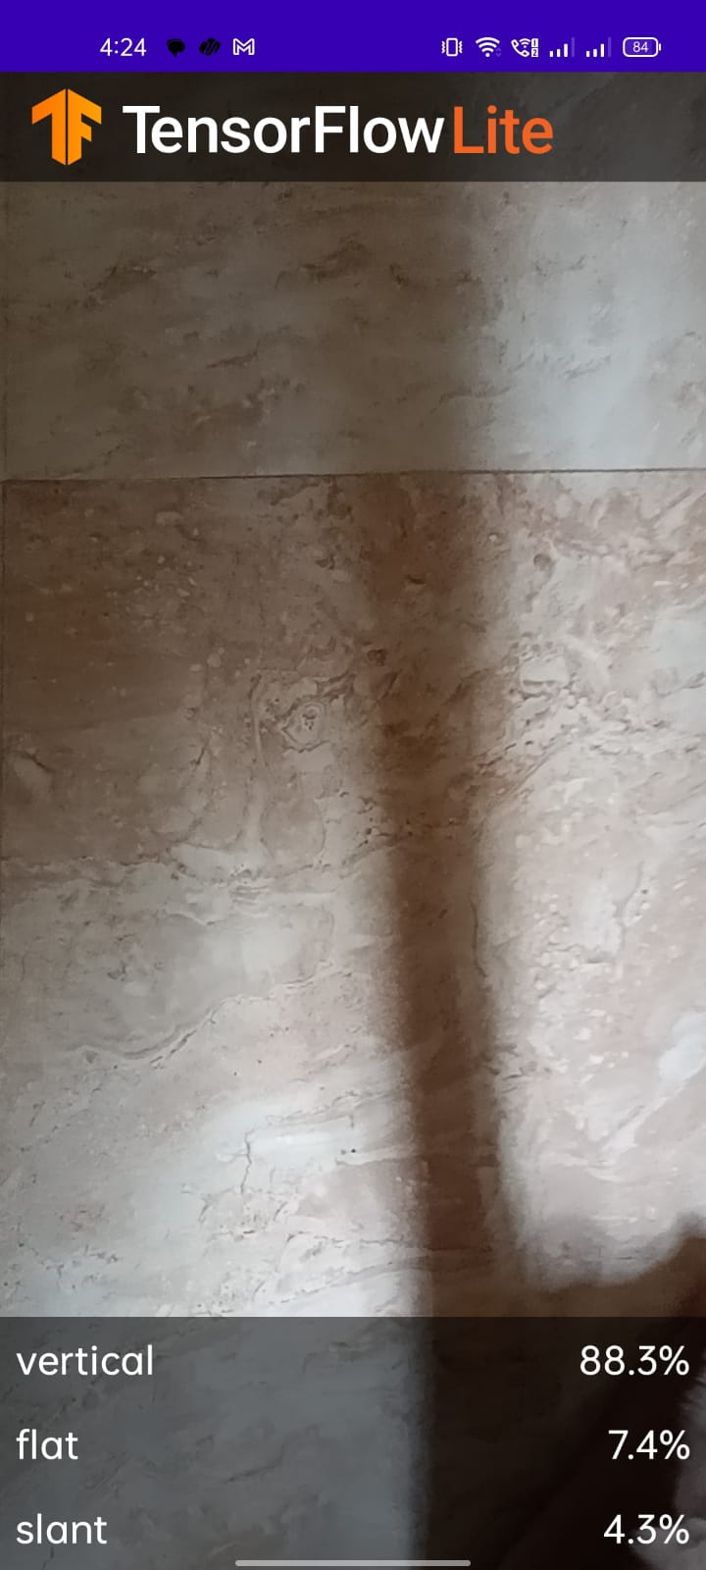
Experimental Results / Simulations / Observations
Results :
(provide numerical data / bar charts / plots / images / videos / tabulated results etc. Use full slide or multiple slides up to max 3 slides to demonstrate the results)

Slide 14
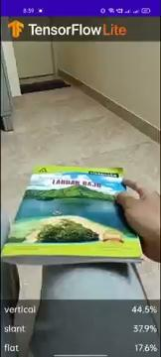
Experimental Results / Simulations / Observations
Results :
(provide numerical data / bar charts / plots / images / videos / tabulated results etc. Use full slide or multiple slides up to max 3 slides to demonstrate the results)
Link to the provided video :
https://youtube.com/shorts/wPp19eHHmTE?feature=share
The video contains the working of the app made for the Surface Classification which classifies the surfaces into Vertical,Flat and Slant surfaces.

Slide 15
Further Plan to Complete Project
Final Probable Deliverables :
(Discuss in the form of bullets, what are the next steps to complete the solution, any road blocks / bottlenecks, any support needed from SRIB)
Dataset for Different Surfaces.
Surface Detection Model.
Dataset for Image Segmentation.
Image Segmentation Model.
Conversion to Mobile App.
Bottleneck : Curating Dataset to distinguish between close up shot of flat surface and vertical surface
IP Target / Plan :
(Any possibility of papers / patentable ideas / innovative aspects that can lead to patentable ideas)
Novel Custom CNN Model for classification of images
Surface Detection.
Image Segmentation model

Slide 16
Further Plan to Complete Project
Completion Plan:
(High level plan to complete the project in next 8 weeks after review, in format below)
Week 1 to 2
Improve Accuracy of Surface Detector.
Week 3 to 4
Image segmentation
Week 5 to 6
Conversion to mobile app
Week 7 to 8
Cleaning of code and improving accuracy
Challenges Anticipated:
Fine tuning the model to get better accuracy.
Procuration of dataset which depicts real world scenario.

Slide 17
Link to CodeBase
Edge Detection - Edge Detection using low level features or A signal processing approach to edge detection.
Surface Defect Detection - Surface Defect Detection
Surface Detection - https://colab.research.google.com/drive/1ZyJf9cpb7ARX2dVU4PG3DYjV60JPQKJl
Link to Dataset
Vertical - https://drive.google.com/drive/folders/1Fp7YX08GaJPge5N5gTtWbHx_oaX0AT4o
Horizontal - https://drive.google.com/file/d/1p3fy2fHdYJH79FNeAQ8NQMUNxkE3jU_V/view?usp=share_link
Slanted - https://drive.google.com/drive/folders/1UbPjbeLqXk0J3ylZHGftCd0Wqovmen21?usp=sharing

Slide 18
Thank you

